Slide 1

Job Analytics with Linkedin Data
Team Members
Aastha Shrivastava
Deeksha Singhal
Ravi Agarwal
Rahul Singh

Slide 2
Contents
Objective
Problem Statement
Challenges
Our Approach
Results
Insights
Learnings

Slide 3
Objective
Perform data analytics to generate useful insights related to job vacancies and job applicants across various cities, industries and designations.

Slide 4
Problem Statement
Compare number of jobs across different cities and designations.
Understand job distribution across various industries
Calculate number of openings in a company as a ratio of their employee count.
Compare job applicants against vacancies for different company size, designations and cities.

Slide 5
Challenges
Learnt Selenium to perform web scrapping.
Data collected from Linkedin using web scrapping was not clean.
Selection of chart to present the data in a meaningful way.

Slide 6
Approach
Step 1: web scrapping
Collected data for job vacancies in india from linkedin including information such as:
    Designation
    Industry
    Linkedin followers
    Applicants
    City
    Company
    Level for that job-
    Involvement-the nature of the job
Used selenium automation tool and python to scrap the data.

Slide 7
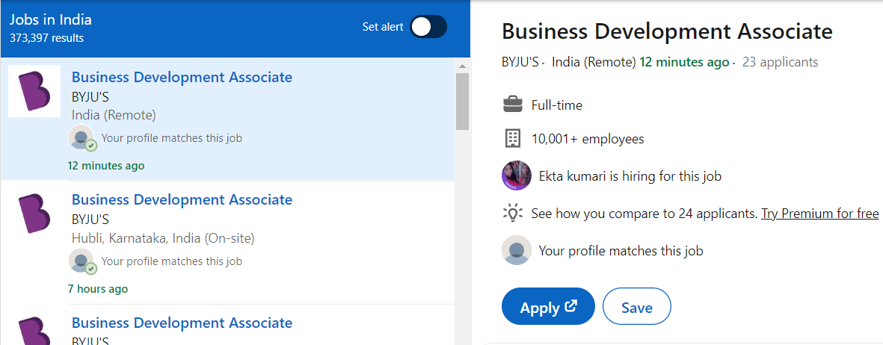
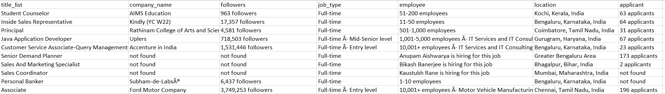
Approach
Step 1: web scrapping

Slide 8
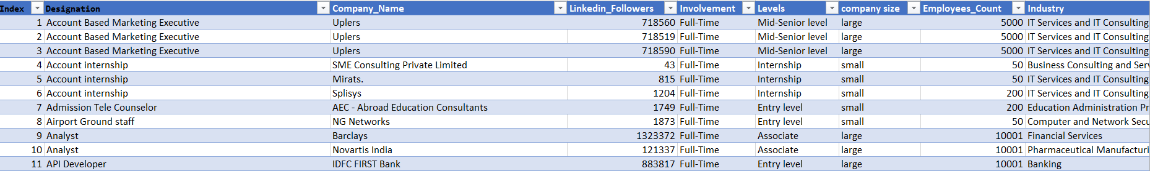
Approach
Step 2: data cleaning
Used excel functions, such as text functions, flash fill to perform data cleaning.

Slide 9
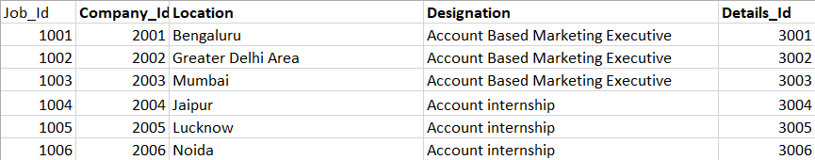
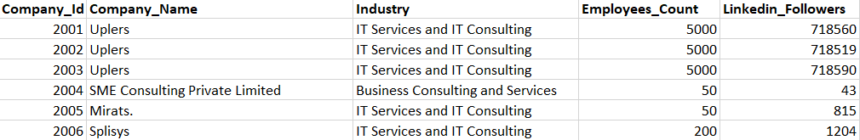
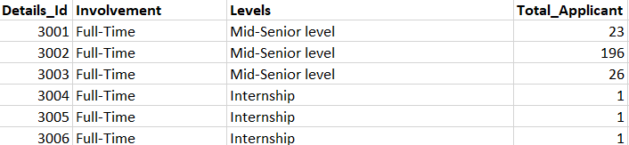
Approach
Step 3: split data into three separate tables

Slide 10
Approach
Step 4: generate results for below using SQL queries
Compare number of jobs across different cities and designations.
Understand job distribution across various industries
Calculate number of openings in a company as a ratio of their employee count.
Compare job applicants against vacancies for different company size, designations and cities.

Slide 11
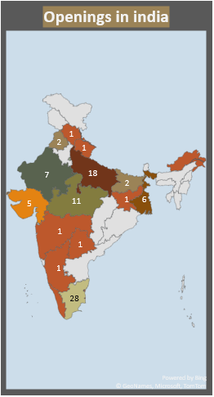
ANALYTICS FROM THE DATA
KPI'S ---->> ||| Applicants/Job : 2.8 ||| Max-Openings : Sutherland and Barclays

Slide 12
Insights and learnings
Fewer jobs in mid-size companies
More applicants but fewer jobs in Chennai
Most entry level jobs are in Chennai
About half of the total openings are in IT industry
Digital marketing has the most opportunities
Significantly higher number of applicants in large and small size companies as compared to medium size companies
Top three states with maximum job openings are Tamil Nadu, Uttar Pradesh and Madhya Pradesh.

Slide 13
Questions?

